Slide 1
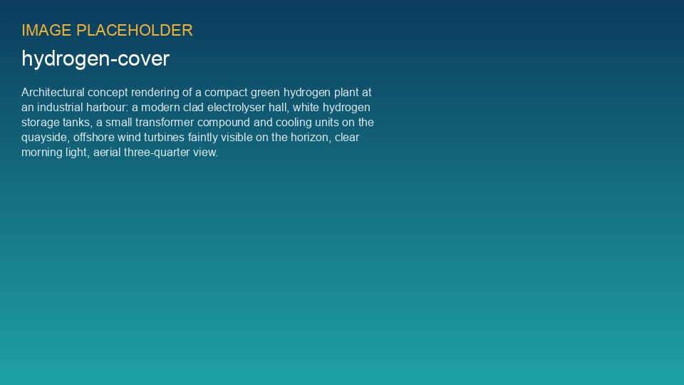
WEYLAND ENERGY
Green Hydrogen Pilot
Feasibility results · Steering Committee 3 September 2026

Slide 2
The answer: feasible
5 MW
481 t
€9.72
€7.66
PEM electrolyser
hydrogen per year
LCOH per kg, no grant
LCOH per kg, with grant
• Below the EUR 8/kg go/no-go threshold with Innovation Fund support
WEYLAND ENERGY · Green Hydrogen Pilot – Feasibility Results
2

Slide 3
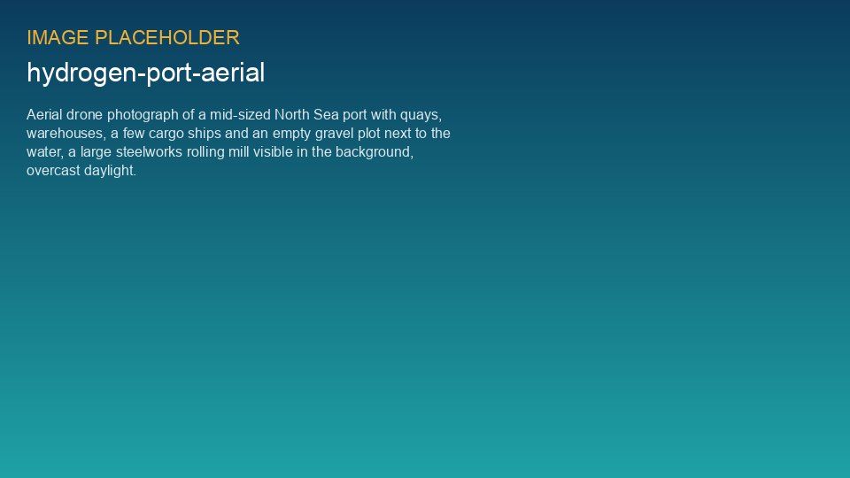
Why Eastholm
Quay plot next to the Harrow Bay O&M base · 1.4 km to the Arcturus rolling mill

Slide 4
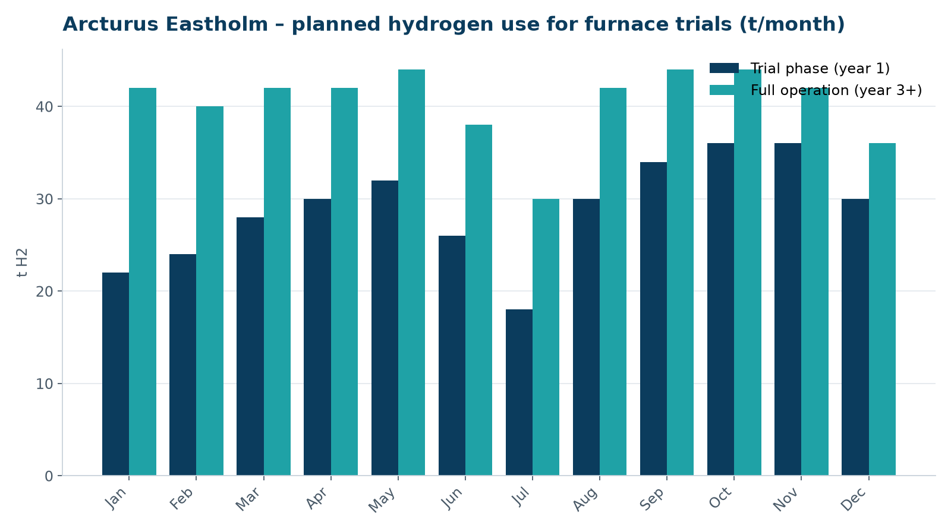
Demand: furnace trials at Arcturus
• Co-firing up to 30 % in the reheating furnace
• Trial year ~330 t, full operation ~490 t/a
• Surplus to local buses via tube trailer
WEYLAND ENERGY · Green Hydrogen Pilot – Feasibility Results
4

Slide 5
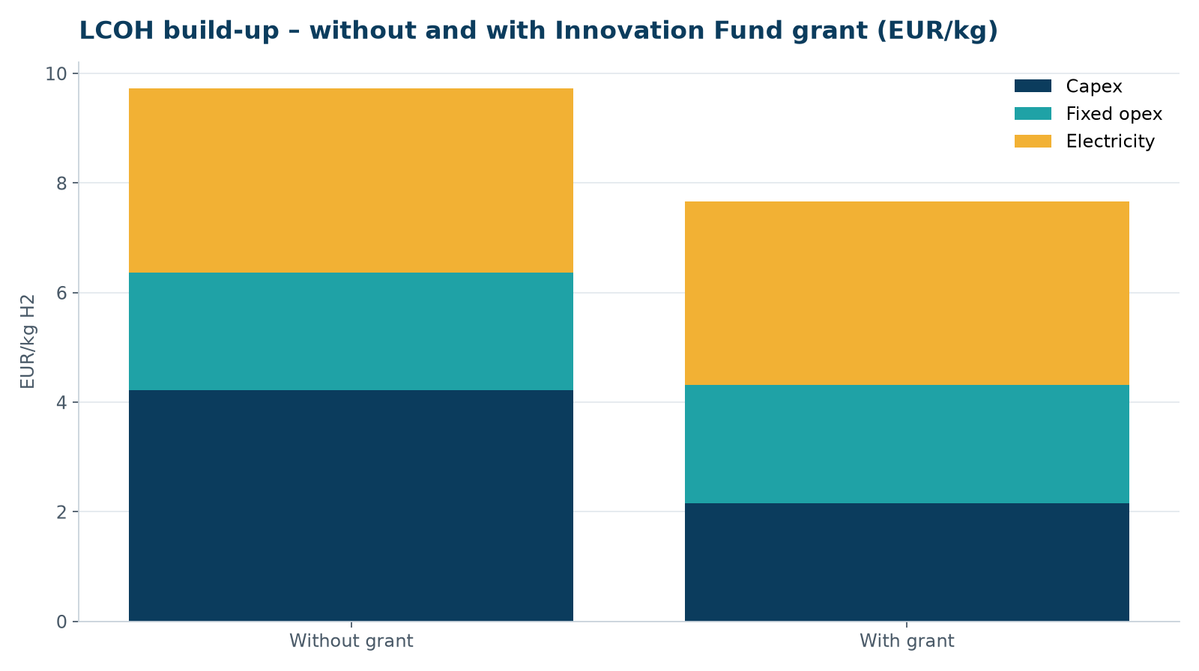
Cost of hydrogen
• Capex dominates without grant – electricity with grant
• Grant of EUR 10.5 m saves ≈ EUR 2.06/kg
WEYLAND ENERGY · Green Hydrogen Pilot – Feasibility Results
5

Slide 6
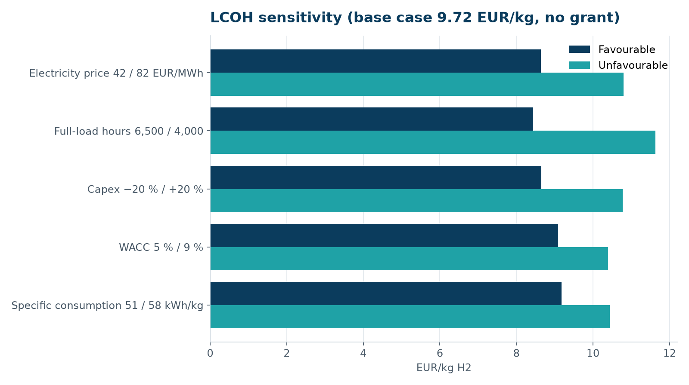
Sensitivities
• Full-load hours and power price dominate
• Sleeved Harrow Bay power hedges the price
WEYLAND ENERGY · Green Hydrogen Pilot – Feasibility Results
6
Notes:
Isabel to explain why 5,200 full-load hours is realistic: grid power in low-price hours fills the gaps.

Slide 7
Next steps
Step | When | Owner
EU Innovation Fund application | Jan 2027 | Isabel Ferreira
FEED with two PEM vendors | Q4 2026 – Q2 2027 | Sofie Lindqvist
Offtake term sheet with Arcturus | Dec 2026 | Priya Nair
Permitting pre-application | Q4 2026 | Isabel Ferreira
FID | Q4 2027 | Steering Committee
WEYLAND ENERGY · Green Hydrogen Pilot – Feasibility Results
7

Slide 8
WEYLAND ENERGY
Decision requested
Approve FEED budget EUR 1.2 m and funding application

